Slide 1
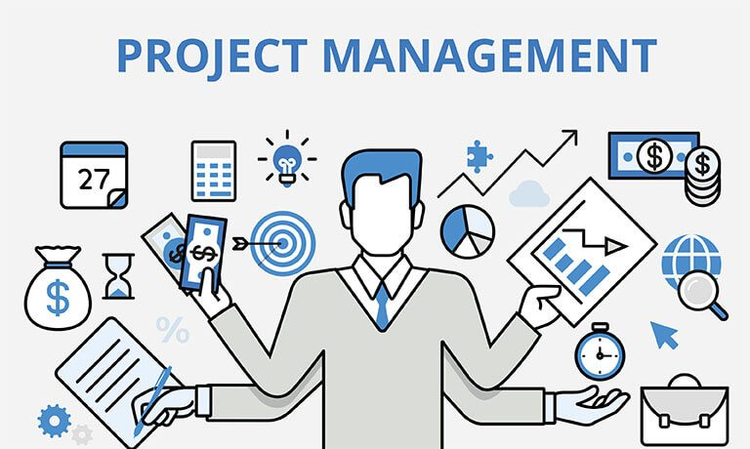

Slide 2
PROJECT MANAGEMNET STANDARDS
IPMA - International Project Management Association, Zürrich
člen: Spoločnosť pre projektové riadenie SR
PCM - Project Cycle Management – European Commission
ICPMA - Construction...
PMI - Project Management Institute /USA/
Literatúra:
Mikolaj,J.: Riadenie investičných projektov. Výber prednášok.
Ž.Ú. KTMS, 2024
Mikolaj,J; Remek,L; Kozel,M.: Riadenie aktív pozemných
komunikácii. ŽU.2024
Doležal,J. a kol.: Projektový management podle IPMA, Grada 2012
Kremeňová I. a kol.: projektový manažment.ŽU. 2009
Svozilova,A.: Projektový management. Grada 2006

Slide 3
Project - management
Design - project doccumentation /buildng, construction.../
Design: architectural, technical, economic, ecological, construction - including requirements and conditions for the construction.

Slide 4
I. PROJECT MANAGEMNT - principles
Basic terminology
Characteristics of project management
Object and structure of project management
ProjectProject features
Project organization
Stakeholders
Participants
Project organizational structure
Project life cycle and project phases

Slide 5
II. Project -Building Investment
Investment process / public works, construction, law /
Public procurement
Environmental impact assessment
Legal background – FIDIC
Evaluation of investment projects
Financing of investment

Slide 6
III. Project management Processess
Project initiation and start-up
Project planning
Project management
Project schedule
Project controlControlling
Computer systems

Slide 7
IV. Asset management
Definitions
Principles
Schemes
calculations

Slide 8
I.Project management Definition
Old forms of line management..... modern matrix organizational structures... to process management
Philosophy: the search for optimal procedures/most advantageous/and means to achieve the goals of all project participants.
Project management is the system of planning, organizing, and managing a project in order to achieve a defined goals
Project management generally includes activities related to the management of an object, service, or combination that is to be created by the project. Construction technologies and procedures are used with an emphasis on achieving the required level of quality of the project outputs. PM is related to the management of costs and economic requirements for efficiency, communication requirements between project participants, building interpersonal relationships.
Project management - differs from the usual form of operational management .... in its temporality and in the allocation of resources for its implementation. When the project objectives are achieved, the project ends. Labor, financial or technological resources are planned and allocated for the project according to its planned needs, and after its completion, these resources are consumed or transferred to other projects.

Slide 9
Project management characteristics
Responsibility is assigned to all activities that are part of the project, regardless of any changes in the implementation staff
The time and cost framework for implementation is clearly identified
Project implementation resources are allocated for the duration of the project and are then released for other projects or consumed, which allows for greater flexibility and efficiency in the use of these resources.
Conditions are created for monitoring the actual progress against the plan, during implementation it is possible to define deviations from the plan and effectively direct corrective actions.
The system of distribution of responsibility for project management and the rules of problem escalation will enable smooth management without the need for excessive supervision by the customer/project sponsor.
Management principles contribute to obtaining approval for meeting or exceeding the planned project goal.
A systems approach to project management generates a range of information that can be used to advantage for the implementation of other projects.

Slide 11
Subject and structure of project management
transformation of the needs and requirements -content of the client into a defined project subject
creation of estimates and assumptions and their transfer to time plans, financial breakdowns and methodological procedures, optimization and modification of these plans
negotiation of resource allocation and processing of supporting documents and project documents for their approval
filling of project tasks, searching for workers suitable for fulfilling a specific task or profession
assignment of tasks and their coordination within the project
Team leadership and motivation of project team members

Slide 12
creating an environment for creating the required quality – designing and implementing quality management procedures, paying attention to the performance of individuals and the progress of assigned tasks, training
checking the progress of project plans, determining the compliance of the actual project progress with the assumptions of the plans
monitoring potentially acting risk impacts, selecting and initiating defensive measures
initiating actions that will correct unwanted deviations from project plans
ensuring the delivery of project outputs to its client
arranging project agendas – final invoicing, compiling final and evaluation internal documents on the progress of the project, releasing project team members and evaluating their individual performance and arranging all property and operational matters and closing accounting agendas.

Slide 13
PROJECT PARTICIPIANTS
SHARE HOLDERS a person who holds at least one share / in a company/
STAKEHOLDERS a person who has an interest but doesn't hold shares.

Slide 15
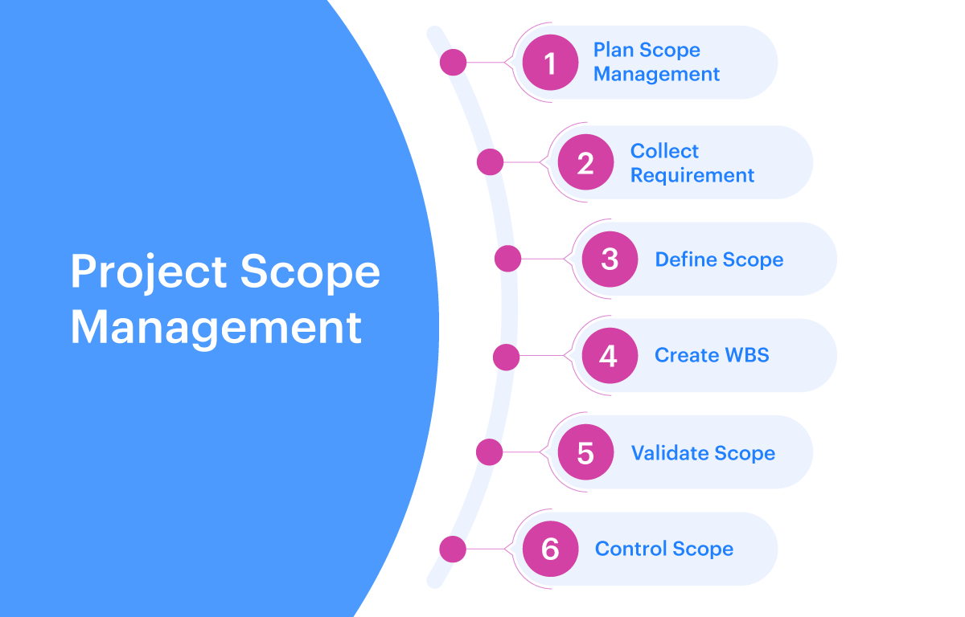

Slide 18
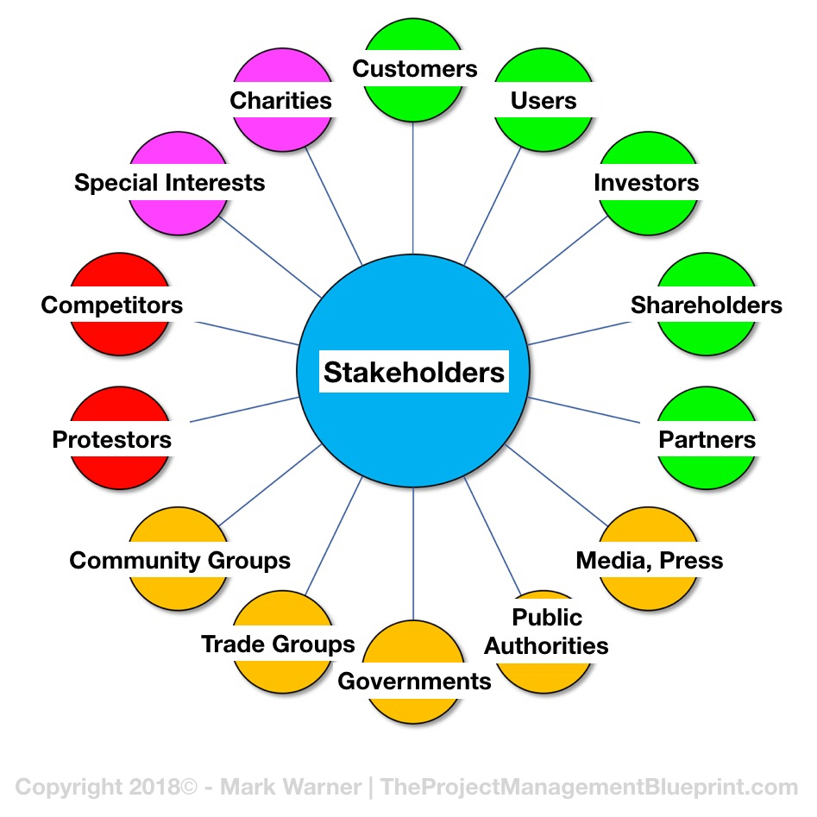

Slide 19
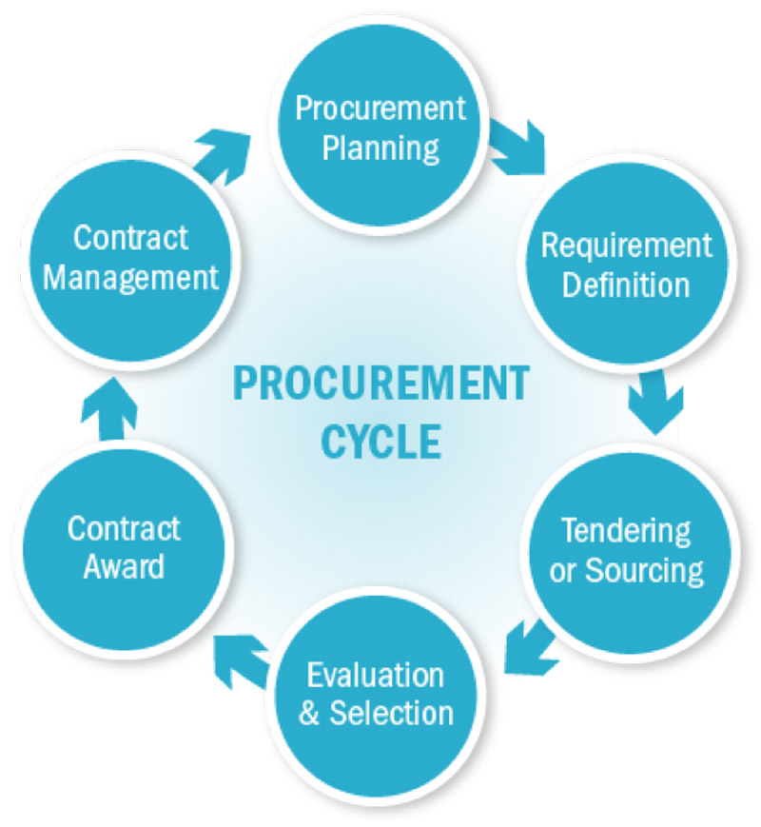

Slide 20
Project
Project is a short-term effort accompanied by the application of knowledge and methods, the purpose of which is to transform material and immaterial resources into a set of objects, services or their combinations so that the set goals are achieved.
Project is any unique sequence of activities and tasks that has:a specific goal to be achieved by its implementationa defined start and end date for implementationa set framework for drawing the resources necessary for its implementation.
Project Is a set of activities and means for a defined desired change in an object with given resources and by a certain deadline.

Slide 21
Project characteristics
Exists for a certain period of time, which corresponds to the duration of the project
has its business goal, which is to be fulfilled by concentrating the activities of people and using material resources
has determined financial limits of the business - available financial resources serving to cover the consumed resources, whether in the form of wages, purchase of buildings, equipment and materials or in the form of rent
has its own organizational structure, which ensures the performance of management, coordination of work and assumption of responsibility for the fulfillment of the business goalhas
a certain degree of independence in decision-making
exists in a certain business environment, which within the framework of the relationships that have arisen contributes to the creation of positive conditions and restrictions

Slide 22
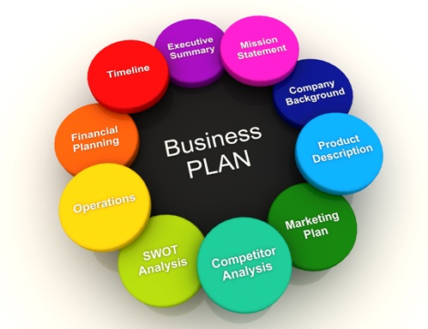

Slide 23
Project division
economic: investment, management, production, research and development,
other: social, sports, culturalWhen applying project management methods and rules, a project can be the reconstruction of a private house, as well as the preparation of a holiday lunch.
Project characteristics:
project subject
time
costs
degree of uncertainty and risks
quality of the implemented outputs

Slide 24
Authority – the power that is assigned to an individual so that he or she can make decisions that arerespected by other individuals
Responsibility – the obligation assumed by an individualto effectively fulfill a given task
Accountability – the ability to fulfill tasks – the state when an individual is able to fulfill expectations and satisfactorily complete aassignment by having both sufficient authority and skillsand responsibility to fulfill this expectation
Accountability = Authority + Responsibility

Slide 25
Project Investor
A company or part of it that is the project investor and for which the project results will serve to fulfill a certain strategic intention or change.
Every project has its own investor who is interested in the implementation of the project and is its sponsor - this is usually a future user of the project product outputs or an investor for whom the implementation of the project means an increase in potential market success through a new product or service that is the subject of the project.
Project Manager /Consultant/
He is a key person in the project investor group, he is the formal holder of the highest decision-making competences in the project. He is essentially the manager of the project investor, who has sufficient authority to decide on the fundamental aspects of the project - the project subject, the budget and the project timeframe.

Slide 26
Characteristics of a project manager:
suitability for a specific job – not every project manager is suitable for every project and the filling of the role should not be subject to the immediate availability of the individual regardless of their previous experience and skills
experience – suitable candidates for managing critical projects or large programs are usually individuals with proven prioritization skills and advanced management tactics and procedures proven in previous projects
technical proficiency in the area of ​​the project
subject matter with customers – some customers require more attention and sharing of information in detail, others have a pragmatic orientation towards results, others place great emphasis on the formal side of management procedures; If the project manager's personality and style are away with the customer's expectations and needs, this can also be a source of conflict.

Slide 28
Aptitude – spôsobilosť, schopnosť
Placement grooming – schopnosť nájsť si prácu, potenciál
Soft skills – mäkké zručnosti, emociálne, komunikácia, práca v tíme
Corporate attitude – podniková kultúra,
Inteship - stáž

Slide 29
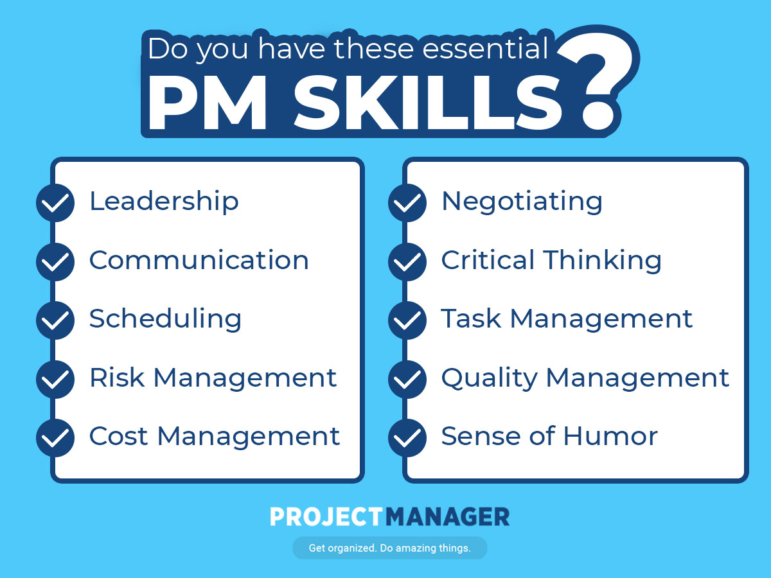

Slide 30
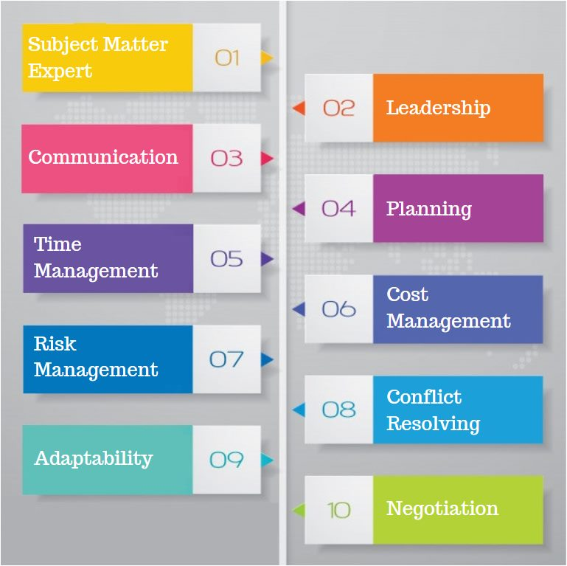

Slide 31
The project manager's responsibility:
managing project resources: time, labor, financial resources, material resources, information technology
planning and control: efficient use of equipment, coordination, reduction of project risks, prevention of undesirable conflicts
managing other entities and processes: the product to be created by the project, relationships between the project and its environment, information flows

Slide 33
Assistant Project Manager
If the scope of the project requires it, the position of Assistant Project Manager is created and filled in the project organizational structure. In justified cases, several such positions may be created simultaneously.
The Assistant Project Manager, according to his/her abilities and experience, performs partial tasks of the project manager, either under his/her direct supervision or with defined limited autonomy.

Slide 34
Project Office
The project office is a supporting administrative body for project management and is usually composed of a project manager and project assistant(s).
The role of the project office is to:
serve all administrative and documentation needs of the project
ensure the smooth running of all project information flows
support project control processes under the direction and for the needs of the project manager
The project office works under the direct direction of the project manager.

Slide 35
Project Team
A project team consists of individuals who are authorized to carry out a specific unit(s) of work with a precisely defined assignment, desired result, within a defined time period, and with a specified workload assumption.
The project team is the main executive element of the project. One of the first tasks of the project planning phase is to establish the project's organizational structure and establish their relationships with the parent organization. The project team is a group of individuals who participate in the implementation of the project's goal and are subject to the management of the project manager during the project period, within the scope of the allocated time or a certain work capacity and within the framework of the assigned competencies and responsibilities.

Slide 36
PROJECT LIFE CYCLUS
A project is a dynamic system that develops in a closed life cycle.
It is carried out in several phases:
Conceptual design – formulation of basic objectives, assessment of benefits and impacts of project implementation, cost estimates and time required for actual implementation, preliminary risk analysis.
Project definition – specification of the outputs of the first phase – diversification of objectives, calculation of subsystems and their internal interfaces, preparation of methodologies and available knowledge and skills, identification of resources, setting a realistic time frame and cost calculation, definition of risks, preparation of detailed plans for project implementation.
Implementation/execution/ – actual implementation or completion of the project – management of work and subcontracts, control of progress according to the schedule and budget, management of communication and necessary project documentation, quality control and effectiveness of achieving individual partial goals, testing of outputs, preparation of documentation as a basis for using the project subject and creation of a support plan in the operational period.

Slide 37
Operational period – actual use of the project object – integration of the project object into the existing organizational systems of the user company, assessment of the technological, social and economic impacts of the implemented project within the framework of the assumptions given in the conceptual period, feedback for planning further projects and assessment of the level of cooperating systems.
Project retirement – ​​transfer of the project object to the support stage and to the possible responsibility of the organization providing support, transfer of resources (e.g. workers or technologies) to other projects, processing of lessons learned and experience gained from managing the given project.
In general, the phases of the project life cycle define:
what type of work is to be performed at the relevant stage of project development
what specific outputs are generated in individual phases, how are they verified and evaluated
who is involved in the project activities in its individual sections

Slide 38
II. Investment projects in construction
The term project management in construction refers to the systematic management of a construction project from its conceptual design to its commissioning.
Investment process: is the process of production /construction/ of tangible investment assets, including the process of preparation, clarification of purposefulness, efficiency, financing, control, acceptance and handover of the asset for use.
It is a time-limited period of preparation and implementation of an investment asset.It includes 4 stages:
1.Design 2.project competition /supplier/, 3. construction, 4. users permission

Slide 39
Investor functions:
securing financial resources for the design, constructing and implementation of the project
selecting the most effective project - from the variants
selecting and preparing land property
legal settlement of land, geometric plan, consents, purchase and sale contracts
project documentation for the construction
environmental study for the construction
requirements for connection to engineering networks
selection of suppliers /tendre/ for construction and technological parts
technical supervision at the construction site,
construction control takeover of the construction,
final approval, occupancy permit evaluation of the implemented construction project

Slide 44
Building Poject Documentations
studies (ŠT),
construction plan documentation / technical, techbnology, economic analysis/
zoning decision documentation (DÚR)
building permit documentation (DSP),
bid documentation (DP),
construction technology documentation
actual construction realisation documentation (DSRS),
final technical and economic evaluation of completed public work (evaluation of public work HVP).

Slide 45
The basic types of studies according to their content are:
• technical (TŠ),
• environmental, i.e. plan,
• special, i.e. noise, emission, traffic-engineering, economic, strategic, planning, prospecting, traffic-urban planning, construction and operation risk study, conceptual, etc.

Slide 46
Act No. 127/1994 Coll. on Environmental Impact Assessment
defines activities subject to mandatory assessment of the following stages:
Intention
scope of assessment
assessment report
public hearing
Evaluation report
final decision

Slide 47
EIA assessment
Apartments - 20,000 m2
Commercial, administr. - 2,000 m2
Schools - 5,000 m2
Roads - 5 km
Bridges - all
Highways and expressways - all

Slide 48
Traffic load, construction cost, profitability analysis
regional development
supply of available clientele
tourism, trade,
lives conditions
ecological construction
land use: agricultural and forest protected
monuments / cultural historic/ waste
air impact on population
noise
vibrations
Emissions
natural environment - geological structure
geodynamic phenomena
geomorphological conditions
climatological conditions
Water: surface and underground
fauna, flora

Slide 49
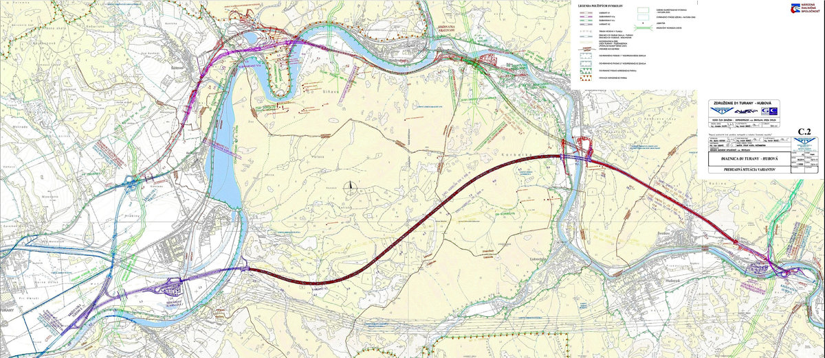

Slide 51
Selected activities in construction - authoritisation
development of land-use planning documents and land-use planning documentation
design of buildings
static calculations of supporting structures of buildings
performance of construction manager activities
performance of construction supervision activities
survey, testing and diagnostics of buildings constructions
geodetic measurements

Slide 52
FIDIC - Federation Internationale des Ingenieurs – Lausanne.
subject of activity: legal conditions of contracts for construction works
red book: construction works / the contracting authority prepares the construction, the risk of changes is divided equally between the contracting authority and the contractor/
yellow book: technological files - the project is transferred to the contractor, the risk also, so almost no changes/amendments/
silver book: key constructions - everything is done by the contractor, no amendments
green book: simpler constructions
the guidelines define the terms: contracting authority, contractor, subcontractor, construction manager - project director, project manager, contract price, description of the work

Slide 53
Evaluation of investment projects
The evaluation of investment projects is carried out using a set of criteria and methods:
analysis of the context and objectives of the project
project identification
feasibility and opportunities
analysis technical description
financial analysis
economic analysis
sensitivity analysis and risk analysis
Financial analysis, economic analysis, sensitivity analysis and risk analysis together form the Cost Benefit Analysis /CBA – Cost Benefit Analysis/

Slide 54
analysis of the Context
involves identifying the level at which the project will operate and generate benefits and costs – i.e.
whether it is a project of regional, national or international importance, - whether it is a public or private project, or a combination of these.
description of the current situation, which is the basis for setting the project objectives.
shuld represent the desired future situation as a change compared to the current situation, achieved by implementing the project.
The project objectives should be:
Specific – definition of specific objectives that the project is to achieve
Measurable – criteria for measuring whether the objective has been met or not (set baseline and target values ​​for key indicators)
Realistic – objectives must be feasible and realistic
Time-bound – a time period must be specified in which the objective is to be achieved

Slide 55
2. Project Identification
Project characteristics and description. Description of works, activities, services, relationship between costs and revenues, definition of project phases.
3. Characteristics and description of the project.
Description of works, activities, services, relationship between costs and revenues, definition of project phases. Feasibility Analysis and Variant Analysis. The purpose of feasibility analysis and variant analysis is to examine all possible variants and decide which one should be selected from a technical, economic and environmental perspective.
„do nothing“ - not the best solution, high maintenance expenditure
„do minimum“ – rehabilitation, repair
„ do something“ - modernization, reconstruction- Cost benefit Analysis

Slide 56
4. Technical Project Description
It is used to compare the project and its costs with other technically comparable projects. The mutual comparability of technically similar projects is used as an important tool for justifying project costs. An integral part of the technical description is a situation map. This should allow for the identification of all the main parts of the project in sufficient detail.
5.Financial /economic/ analysis
represent calculations of complex indicators based on projected cash flows and revenues/costs.

Slide 57
methods – Cost Benefit Analysis
Discounted Cash-flow, DCF
Net Present Value, NPV
Profitability Index
Internal Rate of Return, IRR)
Payback Period

Slide 58
Discounting
is a financial method that allows for the comparison of revenues, costs, and cash flows incurred over different time periods.
The present value of future cash flows can be determined by discounting them using an interest rate that reflects the interest that can be earned on an alternative investment +/- risk and liquidity. The discount factor for adjusting future cash flows (costs, revenues, benefits) for a specific year of the reference period is equal to
1/(1 + k)^{n}
where: k – real discount rate in %
n – year of the reference period

Slide 59
Net Present Value
Net present value is the difference between the present value of expected cash flows and the cost of an investment
Where:
NPV - net present value of an investment
CF - expected cash flow value in period t
IC - cost of investment
k - cost of capital of the investment (discount rate)t - 0 to n - life of the investment
$$NPV=CF− IC= \sum_{t=0}^{n}{\frac{{CF}_{t}}{{\left(1+k\right)}^{t}}}−IC$$

Slide 60
Profitability Index
$\frac{{CF}_{t}}{{\left(IC\right)}^{t}}$ > 1
If the index value is > 1, we can accept the investment.
We will also use it when comparing options: from two options, we choose the one with the larger index.

Slide 61
Internal Rate of Return – IRR
is the interest rate at which the present value of cash receipts from an investment project equals the investment expenditure
$$CF=IC$$
$$\sum_{t=0}^{n}{\frac{{CF}_{t}}{{(1+k)}^{t}}}=IC$$
K – interset rate - consider to: ECB + bank margin
The payback period
is the period over which the cash flow will bring a value equal to the original cost of the investment.
$\frac{{CF}_{t}}{IC }$

Slide 62
Economic analysis
The main difference is that the financial analysis is usually prepared on behalf of the owner of the infrastructure (unless the owner is the state), while the economic analysis is evaluated from the perspective of the entire society (especially in the case of transport structures).
Sensitivity and risk analysis
The purpose of sensitivity analysis is to quantify the sensitivity of financial and economic indicators to changes in specific variables and subsequently identify critical variables. Critical variables are those that can cause significant differences in the projected financial and economic indicators. The sensitivity of specific input parameters can be determined by changing one of the inputs, while the other inputs remain unchanged, and then comparing the quantified change in output indicators with the baseline scenario (original parameter settings). Parameters must be tested in their initial form, i.e. the main inputs must be tested.

Slide 63
Risk analysis is an extension of sensitivity analysis. Its purpose is to understand the probability distribution for critical variables, analyze the risk arising from the distribution, assess whether the risk is within acceptable limits, and manage the risk.

Slide 64
Methods of financing transport infrastructure:
- state budget: national agency : NDS a.s. motorways, SSC – I.class roads
regional agencies – II. and III.clas
income tax: municipalities
roads tolls
EU programs
LOANS – state garantee
PPP - projects

Slide 65
Public-private partnerships have been developing significantly in the last 10-15 years, when there is a shortage of public resources and a surplus of private investment capital. Therefore, opportunities are being sought to use these capacities in large public, especially transport infrastructure projects such as the construction of highways, railways, water management structures, but also hospitals, etc.
Advantages:
1. Obtaining private investment capital /financial resources/ for the construction and operation of transport projects/ without state participation/
2. Introduction of commercial principles of market economy into public projects. More efficient design designs, cost savings, work management methods, etc.
Disadvantages: More expensive credit terms /commercial loans/ and thus an increase in the price of the project

Slide 66
Private Sector Participation Models
Project Finance / Project Finance/
Shadow Tool /Shadow Tool/
Leasing /Leasing/
BOT /Build - Operate - Transfer/
DBFO /Design - Build - Finance - Operate/
BOO /Build - Own – Operate/
BTO /Build - Transform - Operate/
BBO /Buy - Build - Operate/
RIO /Lease - Improve - Operate/

Slide 67
Project Finance
It consists in financing a project, when the lender oversees the cash flow of the project and considers it as a deposit for repaying the loan provided. At the same time, it considers the assets of the project as collateral for the loan provided. Eg. development projects
Shadow toll
A shadow toll is a fee paid by the state to a private investor as compensation for a toll system.
Leasing
Under the leasing method, the state guarantees the concessionaire that it will pay fees/leasing/ for the use of the road. The concessionaire - selected through public procurement - will have the opportunity to build a new road, "own" it and operate it.

Slide 69
BOT /Build, Operate and Transform/
The principle is that the state transfers to the concessionaire for a certain period of time - e.g. 30 years - a motorway section prepared for investment /issued building permit /, with the concessionaire financially and operationally ensuring the construction and operation of the motorway section in question.
The state also transfers to the concessionaire the right to collect fees for the use of the section in question. The maximum amount of this fee is determined by the concession agreement.
After the concession agreement expires /it does not always have to be a period, but e.g. also the achievement of an appropriate profit price/, the entire infrastructure /motorway + equipment/ is transferred to the state free of charge.

Slide 70
Advantages for the state:
the state does not have to finance the construction and operation of the motorway from its budget
all the benefits resulting from the construction itself /employment, taxes, reduction of accidents, land appreciation, etc./ however, remain for the state in the form as if it had financed the construction of the motorway itself
fixed prices
transfer of risk to the investor
higher efficiency /private sector/This method is not applicable in
E.G.: Slovakia because the collection from the toll is not enough to pay for the construction and operation of motorway sections.

Slide 71
DBFO /Design, Build, Finance and Operate/
The DBFO method consists in the fact that a private company selected on the basis of a tender procedure receives a license for the construction (including project preparation), ownership and operation of a section of highways for an indefinite period of time.

Slide 72
In Slovakia, a modification of two methods is used. These are the DBFO and BOT models. The state collects the toll and pays the concessionaire for construction and operation in installments over the concession period of 30 years.
Advantage: The interest is not so high, because of state back payments. No risk about toll income – number of vehicles and price. The state payments are split for 30 years, after construction finished.
Disadvantage: No real PPP project, state is financing complet project.

Slide 73
Public Sector Comparator
It specifies quantitative tools on the basis of which the contracting authority will determine, compared to the traditional method of project implementation. It will achieve greater efficiency of the funds spent by implementing the project in the form of PPP.
When comparing models, it is necessary to base it on an assessment of:
time parameters of the model
general assumptions of the model
financial assumptions of the models
operational assumptions of the model
other assumptions that must be taken into account in the models

Slide 74
While the costs of the provided loan financing -public are expressed in terms of interest rate and bank fees, the costs of the provided own resources of the private partner are expressed in terms of the required internal rate of return – IRR. There are several ways to determine the required IRR of the private partner. The simplest is the Capital Asset Pricing Model – CAPM.According to this method, the return that the private partner will require is determined based on the following formula:
ke - required return IRR for the investor
rf - risk-free interest rate - the basic component of the required internal rate of return is set at the level of government bond yields with a comparable maturity to the life of the PPP project.
ßL – in debt, adjusted for the indebtedness of the company. This includes the increased risk for the company associated with long-term financing in the project

Slide 75
(rm – rf) - market premium - the market premium is denoted by (rm – rf), which can be interpreted as the difference between the long-term return on stock markets (rm) and the return on risk-free bonds (rf).
SP - size premium - (Size Premium, SP) - investing in a smaller (financially less stable) company is generally considered riskier, and therefore the investor requires a higher return on his funds as a premium for the additional risk taken.

Slide 76
Information Systems
Microsoft Dynamics NAV
Microsoft Business Solutions – Navision
etc
This system is used by construction companies all over the world, as it is a product from Microsoft. The system allows for production and financial monitoring of construction activities in the Microsoft Dynamics NAV environment. The Construction Production module allows for the management of construction activities from the perspective of project or order implementation.
Orders are recorded on the Project Card, where the following information is available:
the order price, which is displayed from the project budget
the number of the main contract
the contractual project start and end
Dates the warranty period and warranty
the status of unfinished production

Slide 77
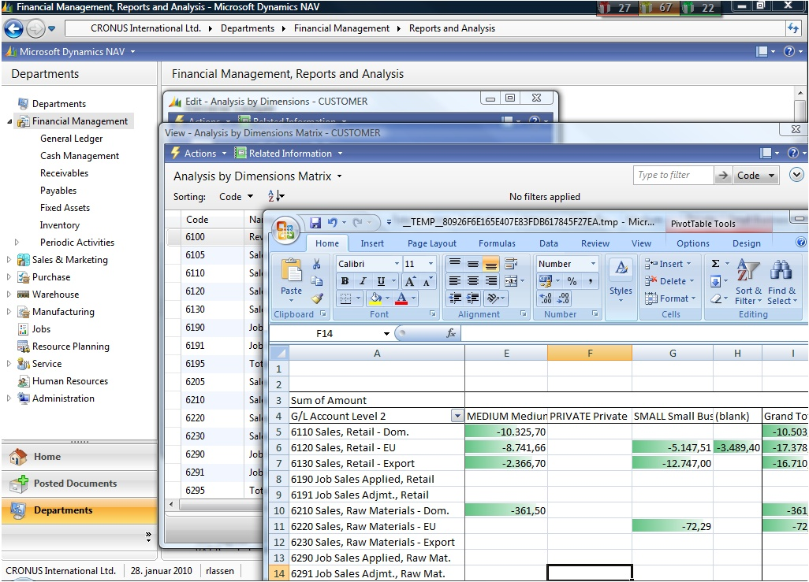
Obr. 3 Programové prostredie Microsoft Dynamics NAV [11]

Slide 78
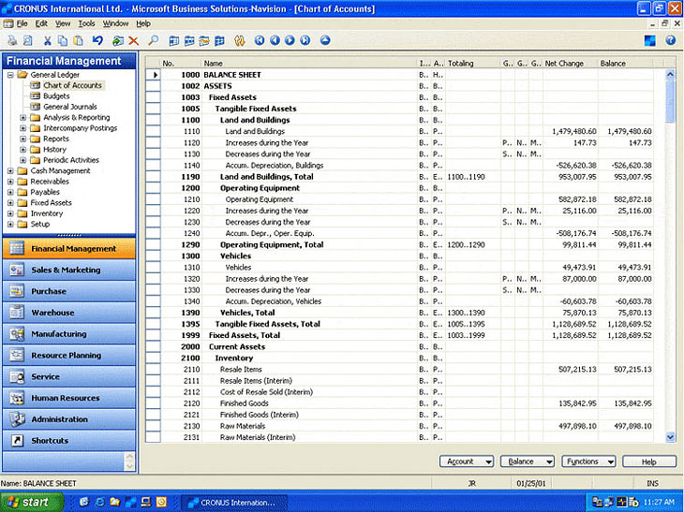
Obr. 4 Programové prostredie Microsoft Business Solutions – Navision [12]

Slide 79
IV. Asset management
Asset management is the systematic process of maintaining, enhancing, and securing tangible assets at a cost-effective cost. It combines engineering principles with business practices and economic theory, and provides tools to facilitate a more organized, logical decision-making process. Asset management thus provides a framework for short-term and long-term planning.
Assets: are economic resources (expressed in value) that are expected to generate future economic benefits. Assets are managed with the aim of increasing the value of the company and the prosperity of its activities.
Asset Value: is determined based on the acquisition price obtained by valuing the asset.
Asset Performance: represents the value of the asset in relation to the level of service that the asset provides.

Slide 80
Infrastructure assets:
Roads, Buildings, Tunnels, Technical equipment (protective devices, signaling devices, lighting devices, barriers, shock absorbers, electronic radar and monitoring devices, operating devices, etc.)
Other assets:
Construction and maintenance equipmentVehiclesReal estate (buildings, property, road and roadside facilities)MaterialsHuman resourcesCompany (organization) data and informationEarth and pipeline transportation equipment and devices

Slide 81
It is necessary to evaluate assets based on their definition from three perspectives:
1. Community Benefits – performance
2. Road System Performance –performance
3. Asset Condition
Community Benefits consists of ensuring transport service to the population, security forces, the supply of available clientele, development of the territory and environmental protection.
Road System Performance consists mainly of ensuring a sufficient category of CK, its directional and elevation guidance so that it meets the requirements arising from the intensity of road traffic and its smooth and safe traffic.
Asset Condition is evaluated by:
1. operational capability /user value/
2. construction and technical condition of the asset. /construction value/. Construction and technical condition is expressed by the ability of the object to withstand traffic loads. We express it by the residual life in proportion to the total life.

Slide 82
Calculation of asset value
In relation to structural value:
The calculate it based on the structural life as the ratio of the current state /expressed by the residual life/ and the optimal state /total life/
$${AV}_{CC}={AAP}_{PC} ×\frac{RLE}{DLE}$$ | (5)
AV_{CC} = value of an asset in current technical condition [€],
AAP_{PC} = acquisition price of the asset in a pristine condition [€],
RLE = residual life expectancy [year],
DLE = designed life expectancy[year].

Slide 83
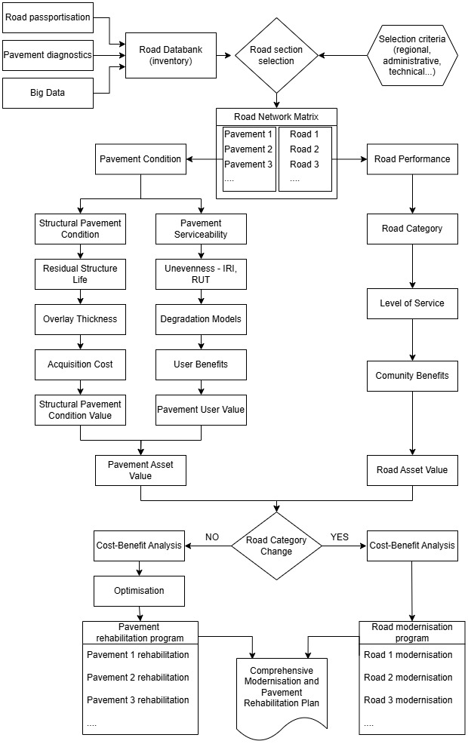

Slide 85
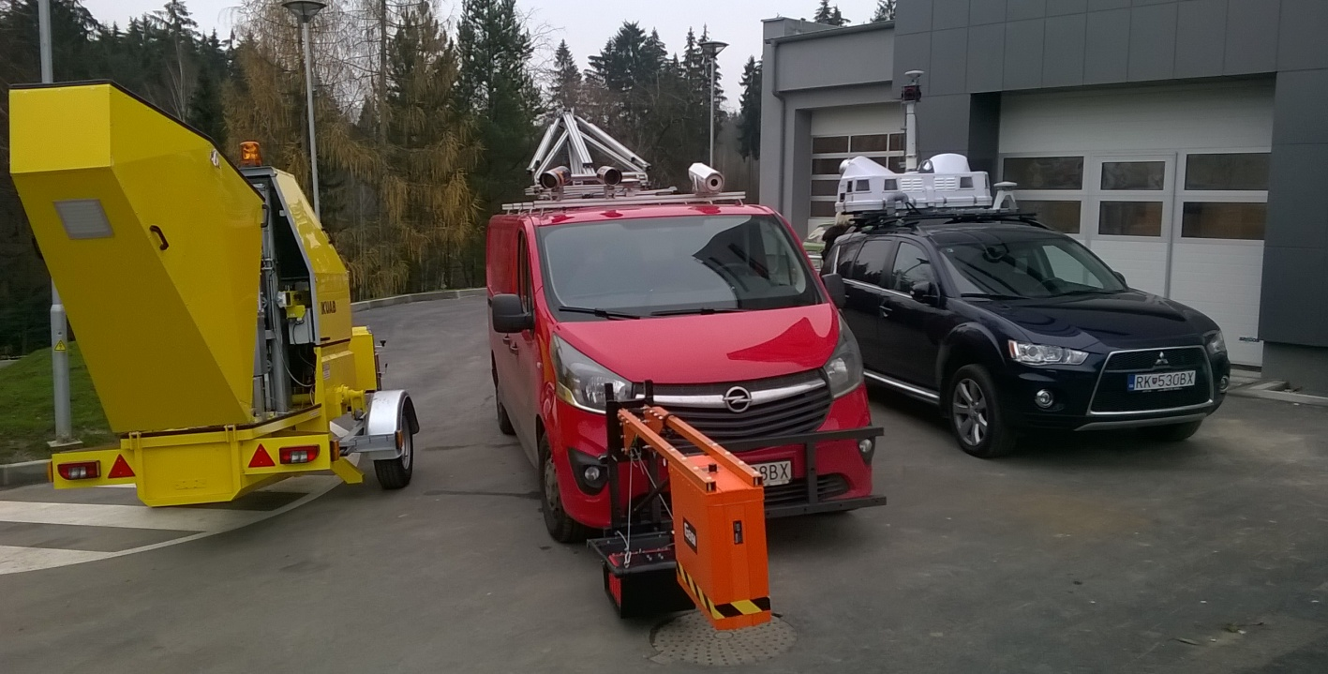
Diagnostická technika - Žilinská univerzita

Slide 86
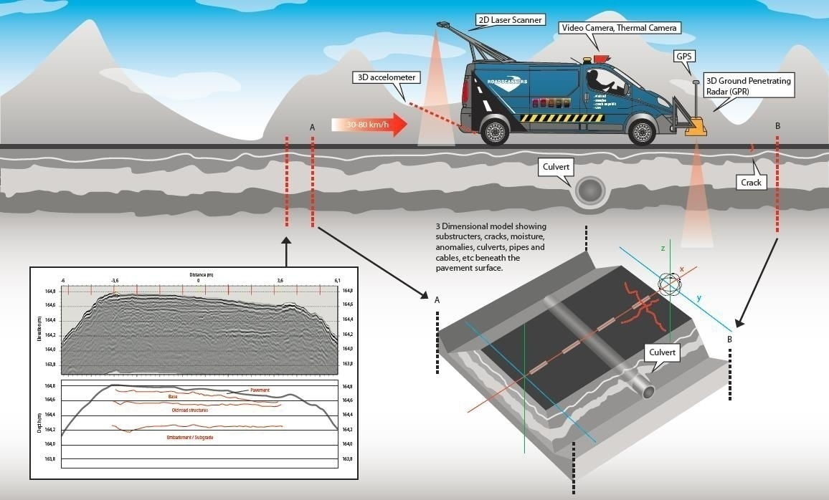

Slide 87
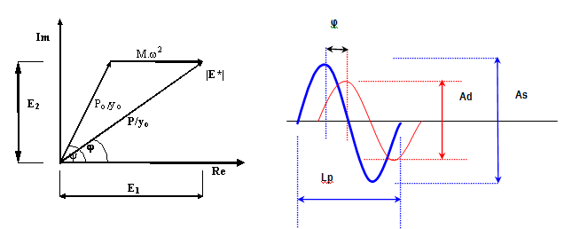
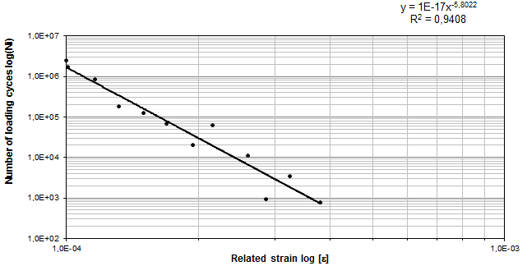
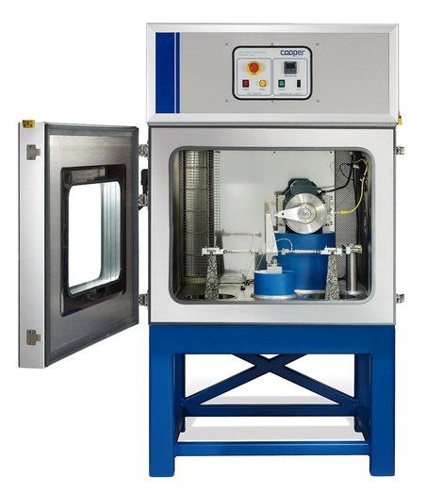
Experimentálne merania koeficientov únavy A, B

Slide 88
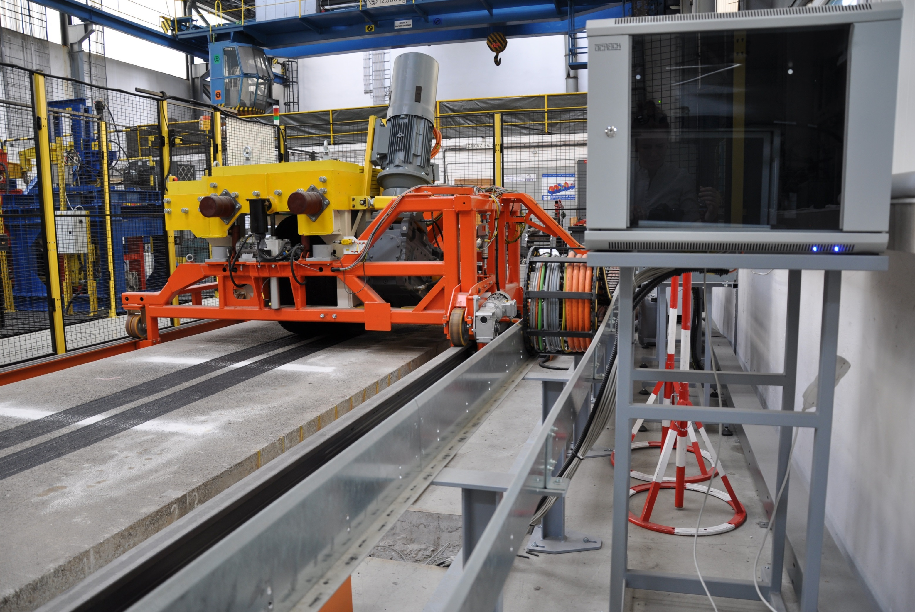
EKONOMICKÁ EFEKTÍVNOST

